Slide 1
Group 8
Saul Rodriguez-Tapia, Aryan Chauhan, Aaron Hodzic

Slide 2
Methodology
We worked independently, with regular check-ins to stay aligned and on schedule.
We used Google docs to compile our work, we used discord for communication and, we used Github to compile our visualizations together.

Slide 3
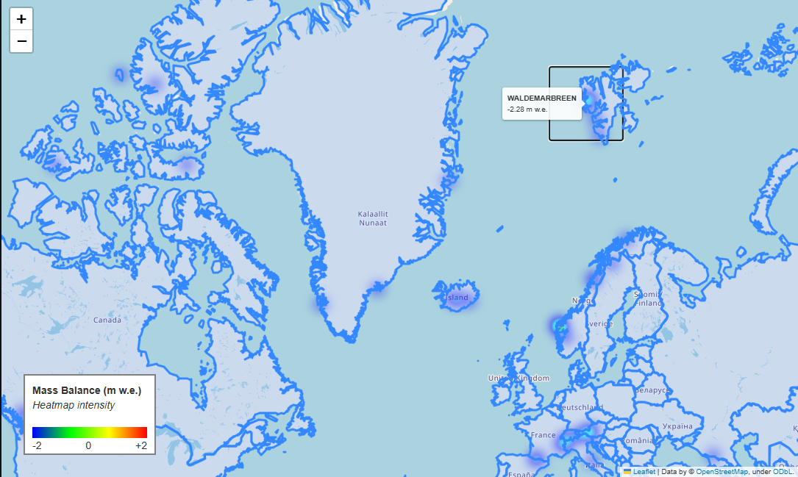
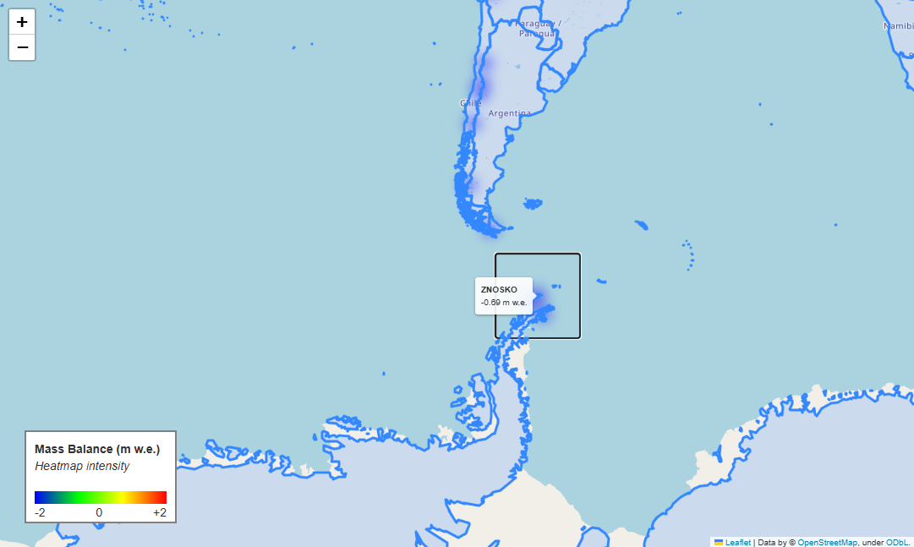
Visual Results 1

Slide 4
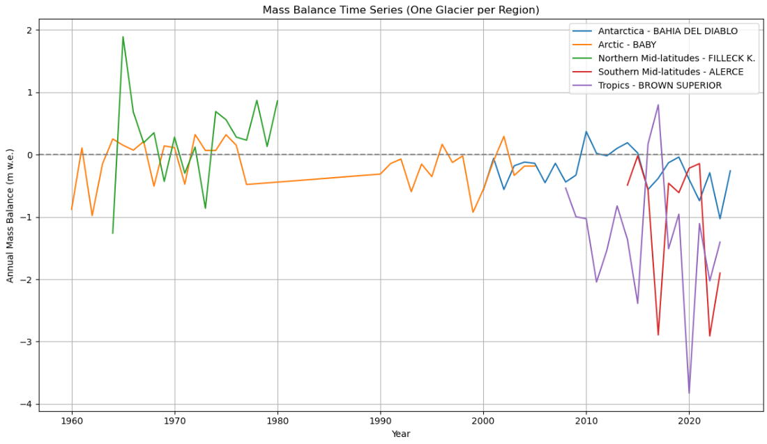
Visual Results 2
Visual Results 2

Slide 5
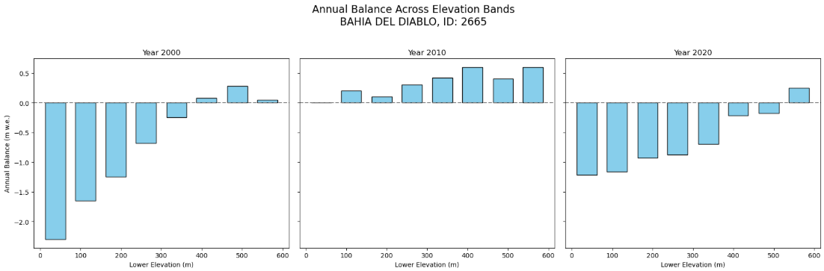
Visual Results 3

Slide 6
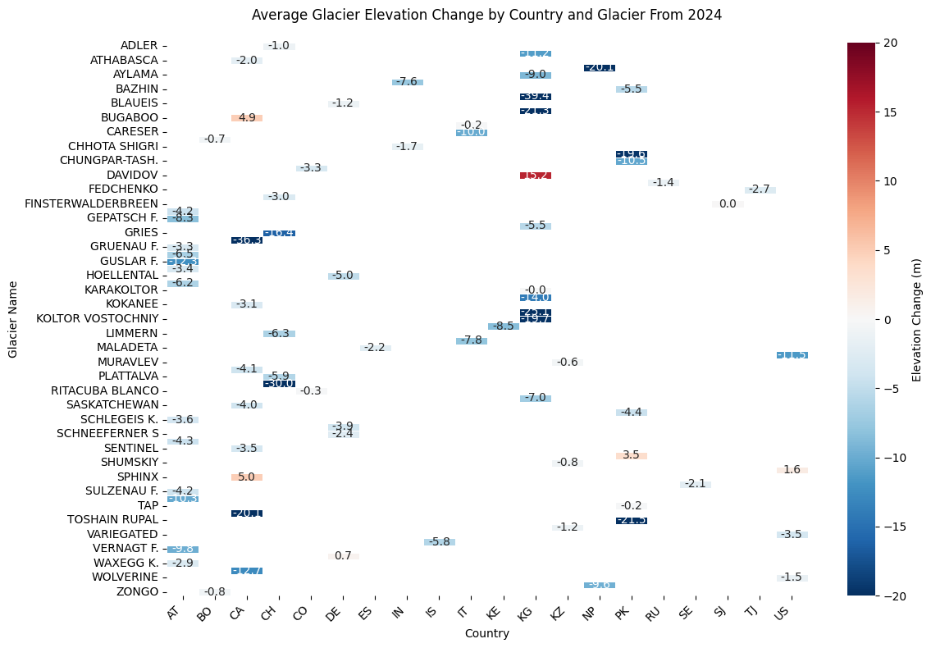
Visual Results 4
Goal: Understand the average glacier elevation change by each country in the last year.
Structure: Horizontal Bar Chart sorted by change in elevation, glacier name and country.
Color mapping: Red indicates a gain in elevation and blue indicated a loss in elevation.
Insight: Elevation change trends in the past year in different countries.
Why It Is Important: Allows us to find trends in elevation change and find the factors in the past year that influence the change.

Slide 7
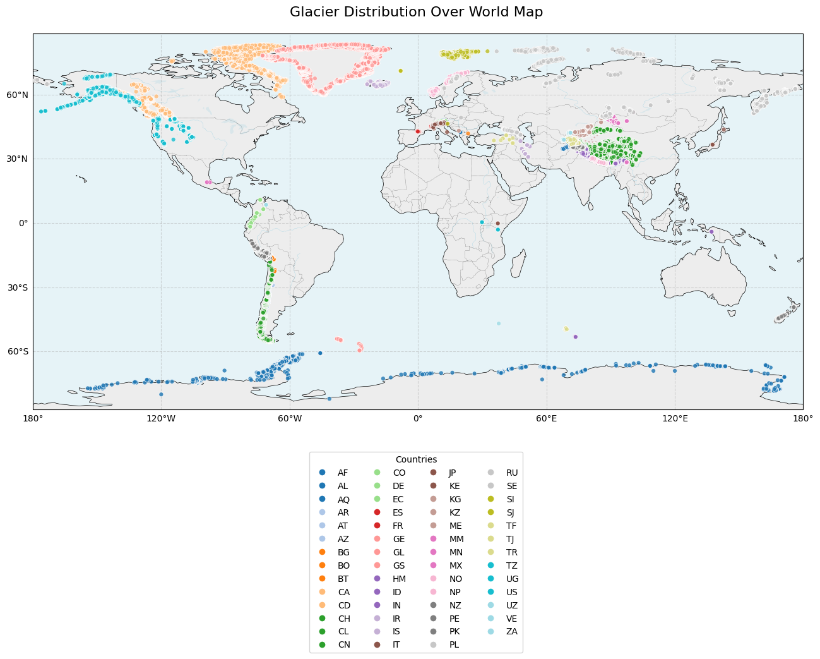
Visualization 5
Goal: Highlight geographical clusters and trends directly on top of a world map.
Structure: A world map with glaciers marked by country on top.
Color mapping: Each country is assigned a designated color for visual clarity.
Insight: Reveals clusters on top of world map to better understand geographical trends.
Why It Is Important: Highlights regions that could have climate and geographical characteristics that could negatively impact glaciers.

Slide 8
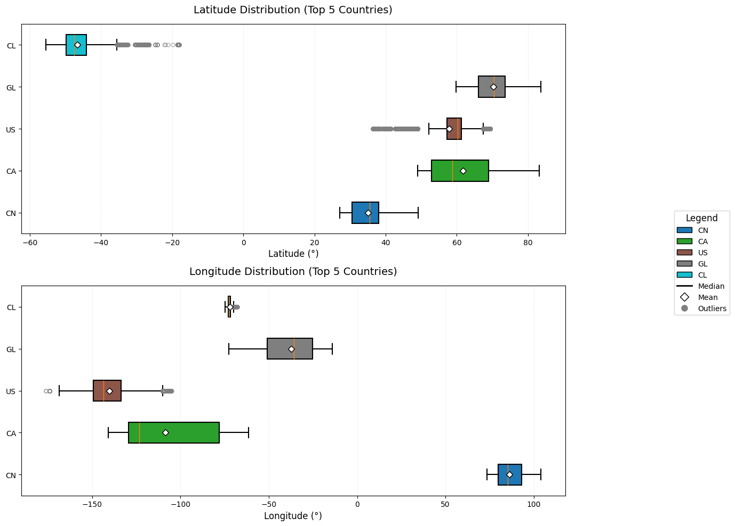
Visualization 6
Goal: Highlights the distribution of glaciers with clearly outlined outliers in the 5 countries with the most glaciers
Structure: The Latitude and Longitude data being separate allows for direct visualization of north-south vs east-west glacier distributions.
Color mapping: Each country is assigned a designated color for visual clarity.
Insight: The interquartile range shows the center of glacier clusters in each country.
Why It Is Important: This visualization is important because it allows for us to understand these distributions to understand geographic patterns and climate influences in each country.

Slide 9
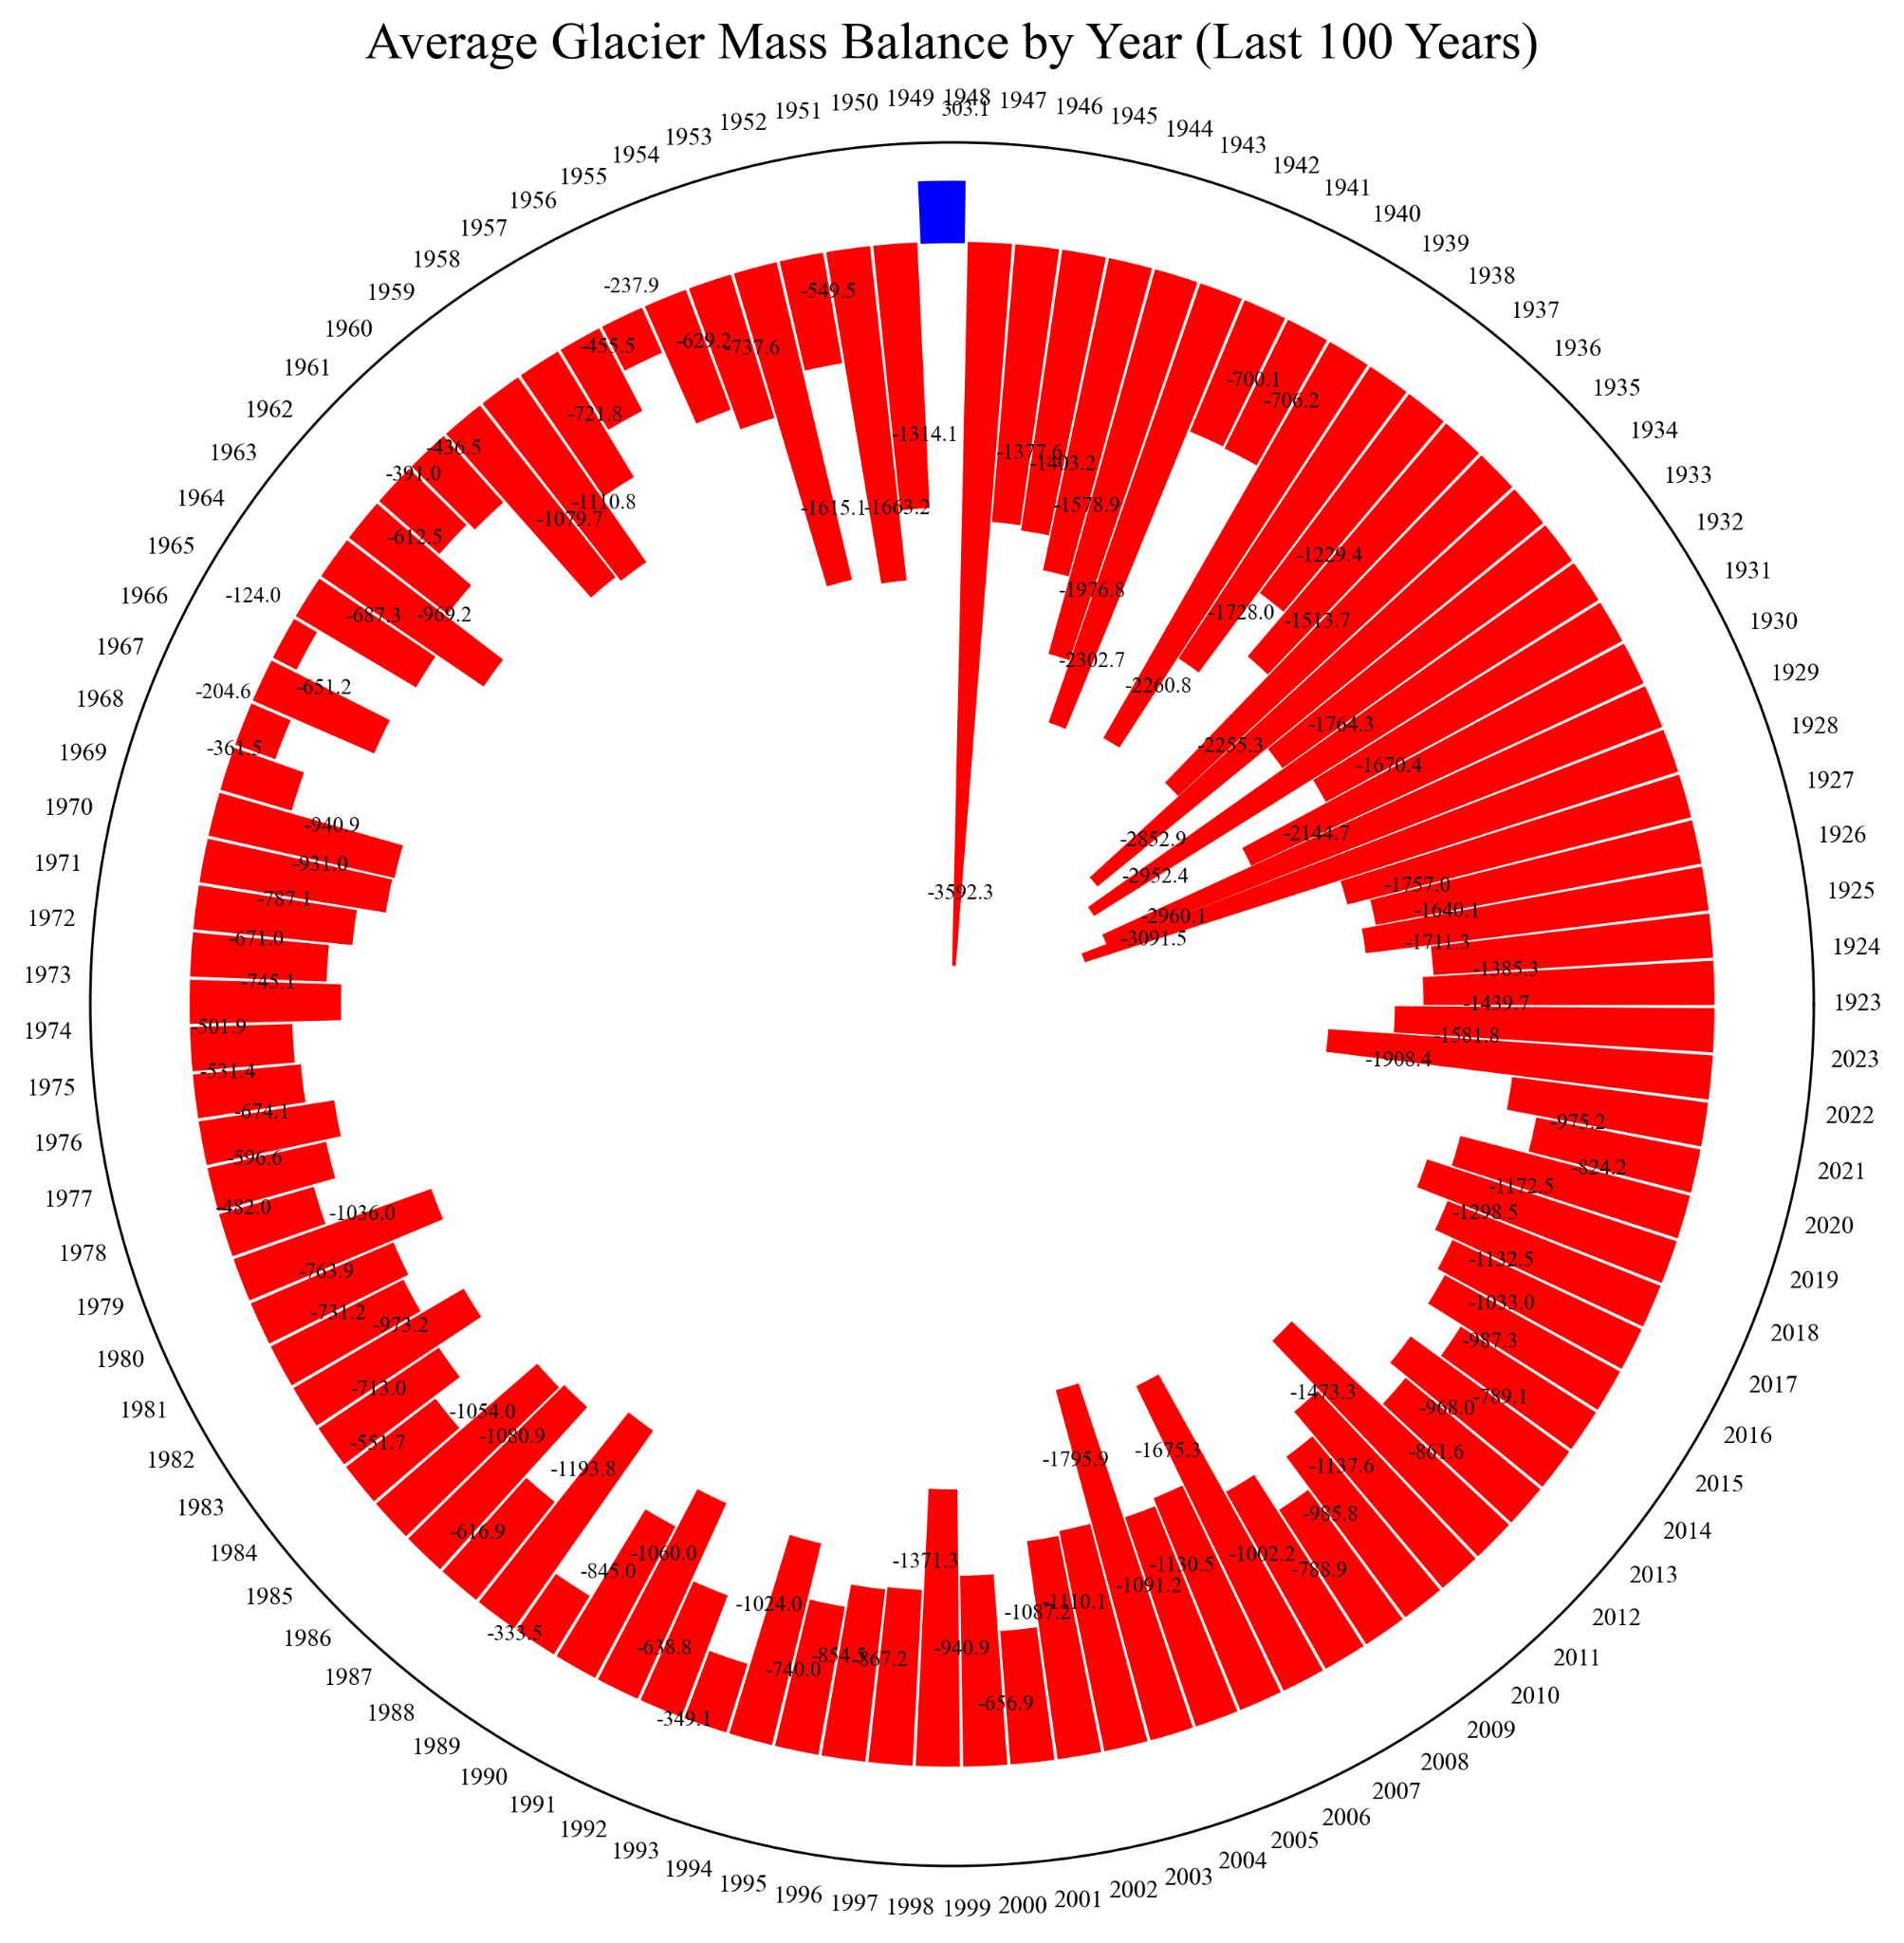
Visualization 7
(radial timeline)
Goal: Highlights cyclical or abrupt changes in mass by displaying glacier mass changes over centuries in a circular timeline.
Structure: To illustrate temporal patterns, each bar is positioned radially by time and represents the mass change in a particular year.
Color mapping: The degree of mass gain or loss is conveyed by a cool-to-warm color gradient (red = loss, blue = gain).
Insight: Shows that the glacier mass balance has decreased significantly since the mid-20th century
Why It Is Important: valuable for pinpointing periods of rapid melting or stabilization, particularly in the context of long-term climate monitoring.

Slide 10
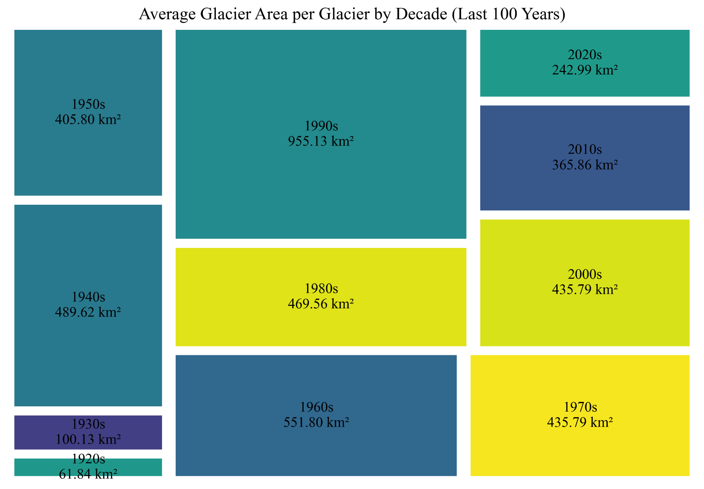
Visualization 8
Goal: to compare glacier metrics (mass, volume, area, and length) by century in terms of their relative sizes.
Structure: To emphasize temporal proportions, nested rectangles group each metric's magnitude within centuries.
Insight: Shows that the average area of the glaciers by decade has decreased from the early 20th century to the early 21st century, most significantly from the 90s to the 2000s.
Labeling: To facilitate visual decoding and accurate comparison, each section includes the century, metric, and exact value.
Why It Matters: Makes it possible to comprehend how glacier structural changes have changed over time, such as whether volume has decreased more precipitously in recent centuries than area or length.

Slide 11
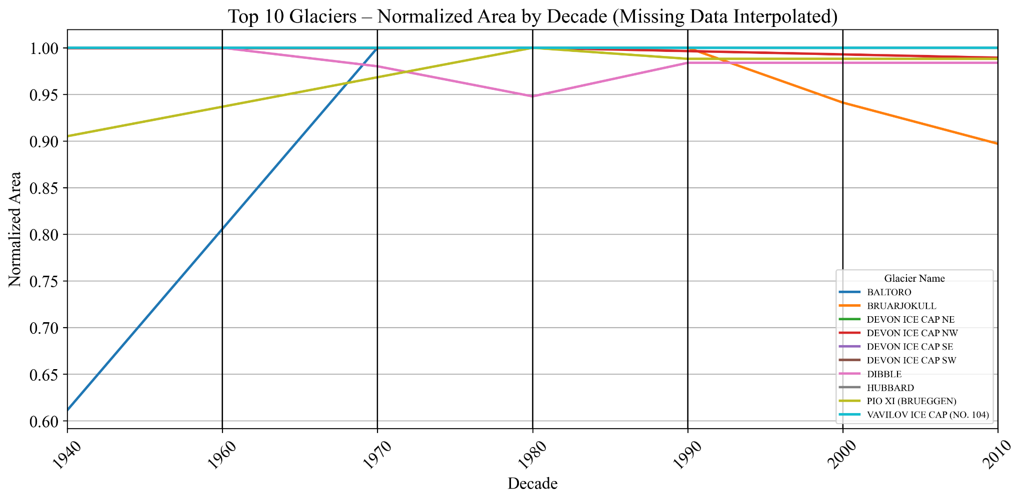
Visualization 9
Goal: Illustrates how four important glacier metrics changed in tandem (or apart) over significant historical epochs.
Structure: It is simple to follow patterns and correlations because each line joins standardized metric values for a single epoch.
Insight: Annotations give quantitative context for visual trends by displaying actual (not normalized) values.
Metrics: Even though different metric scales (such as mass vs. area) exist, normalization allows for fair comparison.
Why It Matters: Indicates interdependencies in the dynamics of glacier retreat by demonstrating the strong correlation between metrics such as mass and volume in loss trends.

Slide 12
Key Insights
Overall most glaciers are melting faster than they’re gaining snow/ice, this demonstrates a global glacier retreat
Glaciers closer to the poles show less negative balances (melt less)

Slide 13
Works Cited
WGMS (2025): Fluctuations of Glaciers (FoG) Database. World Glacier Monitoring Service (WGMS), Zurich, Switzerland. https://doi.org/10.5904/wgms-fog-2025-02b

